Slide 1

CUSTOMER CHURN IN DIGITAL BANKING: A CASE STUDY OF BILLDESK BANK

Slide 2

Table of content
Title Page
Table of content
Names of Group Member
Introduction
Project Description
Data Description
Dashboard Overview
Discovering and Presenting Insight
Actionable Recommendation

Slide 3
GROUP MEMBERS
OLOYEDE OLUGBENGA OLOYEDE
ABDULAZEEZ TESLIMAH OMOBOLANLE
TIETIE MARY BOLUWATIFE
YISA TAIWO
IBRAHIM JAAFAR OLAMILEKAN

Slide 4

INTRODUCTION
This project focuses on BillDesk Bank Customer Churn Dataset to analyse customer behavior and predict churn, which refers to the phenomenon of customers leaving a service or business. Customer retention is critical for businesses like banks, where acquiring new customers often costs more than retaining existing ones. Understanding the factors that contribute to customer churn can help banks make informed decisions, enhance customer service, and implement strategies to reduce churn.
BillDesk is a leading Indian payment gateway and financial technology company founded in 2000 by M.N. Srinivasu, Ajay Kaushal, and Karthik Ganapathy. They provides online payment solutions for businesses and individuals of all sizes to help them accelerate their growth and digital transformation. They operates in several regions. However, this analysis focuses on three major countries namely; France, Spain and Germany

Slide 5
PROJECT DESCRIPTION
The dataset consists of key information about BillDesk customers. The primary goal of this analysis is to:
Understand customer demographics and behavior: By analyzing the dataset, we can identify patterns in the data that are associated with customers who stay against those who leave.
Identify factors influencing churn: Factors like customer age, credit score, and activity status are analyzed to find correlations with customer churn.
Recommend strategies: Based on the insights gained, we will suggest strategies to improve customer retention. This presentation will walk through the findings from the dataset analysis, highlighting important factors contributing to churn and discussing the steps banks can take to improve customer retention

Slide 6
DATA DESCRIPTION
The dataset contains the following columns:
Customer Id—contains random values and has no effect on customer leaving the bank.
Surname—the surname of a customer has no impact on their decision to leave the bank.
Credit Score—can have an effect on customer churn, since a customer with a higher credit score is less likely to leave the bank.
Geography—a customer’s location can affect their decision to leave the bank.
Gender—it’s interesting to explore whether gender plays a role in a customer leaving the bank.
Age—this is certainly relevant, since older customers are less likely to leave their bank than younger ones.
Tenure—refers to the number of years that the customer has been a client of the bank. Normally, older clients are more loyal and less likely to leave a bank.
Balance—also a very good indicator of customer churn, as people with a higher balance in their accounts are less likely to leave the bank compared to those with lower balances.
Number Of Products—refers to the number of products that a customer has purchased through the bank.

Slide 7
DATA DESCRIPTION
Has Credit Card—denotes whether or not a customer has a credit card. This column is also relevant, since people with a credit card are less likely to leave the bank.
Is Active Member—active customers are less likely to leave the bank
Estimated Salary—as with balance, people with lower salaries are more likely to leave the bank compared to those with higher salaries.
Exited—whether or not the customer left the bank.
Acknowledgements:
As we know, it is much more expensive to sign in a new client than keeping an existing one. It is advantageous for banks to know what leads a client towards the decision to leave the company.
Churn prevention allows companies to develop loyalty programs and retention campaigns to keep as many customers as possible.
Data Source: Kaggle.com https://www.kaggle.com/datasets/mathchi/churn-for-bank-customers

Slide 8
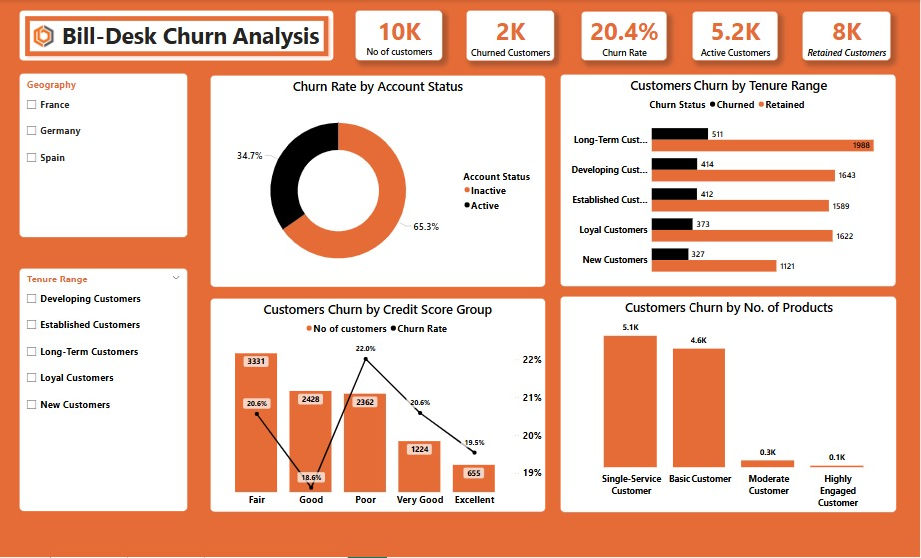
Dashboard Overview

Slide 9
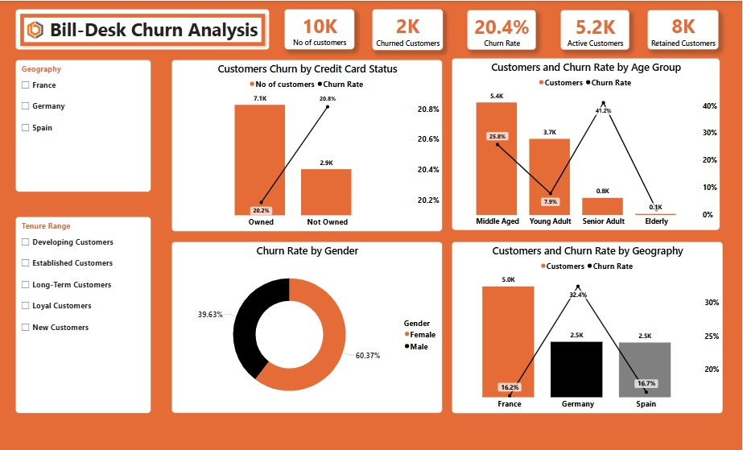
Dashboard Overview

Slide 10
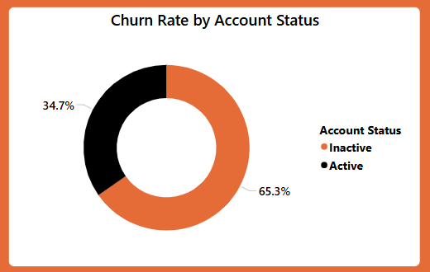
Discovering and Presenting Insight
Insight:
Analysis shows that inactive customers are the most at risk of churning.
Causes:
Customers leave due to poor engagement, high fees, better competitor offers, and bad service. Some accounts were opened for one-time use and are no longer needed

Slide 11
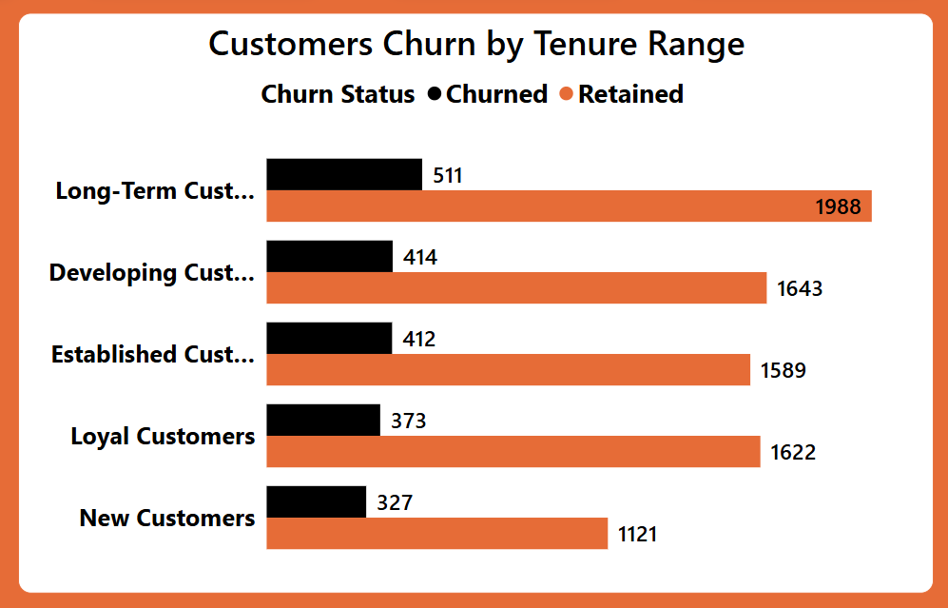
Insight:
Analysis shows that long term Customers (7 years and above) have the highest churn rate.
Causes:
The fact that long-term customers have the highest churn rate suggests dissatisfaction even among those who have been with the bank for years. This could indicate issues with service quality, uncompetitive offerings, or unmet expectations. The bank should investigate why loyal customers are leaving.

Slide 12
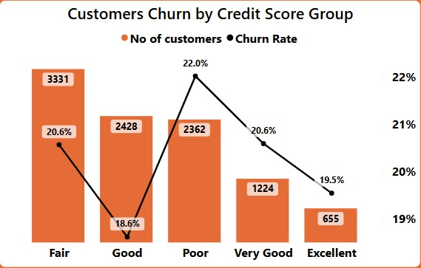
Insight:
Analysis shows that customers with poor credit score have the highest churn rate.
Causes: Customers with a poor credit score having the highest churn rate suggests they may be struggling financially.

Slide 13
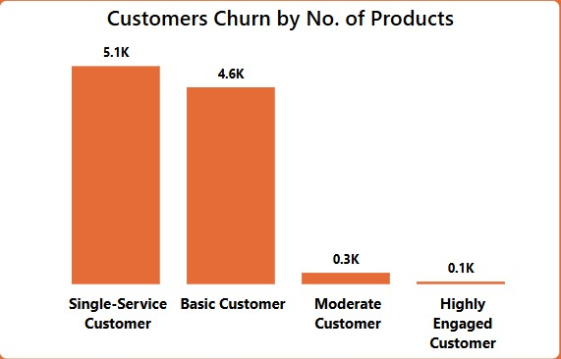
Insight:
Analysis shows that Highly Engaged Customers (4 products users) and Moderate Customers (3 products users) have the lowest churn rates.
Causes: Low engagement and weak customer loyalty among single-service users. Customers with fewer products may find it easier to switch to competitors, while those using multiple products are more invested and less likely to leave

Slide 14
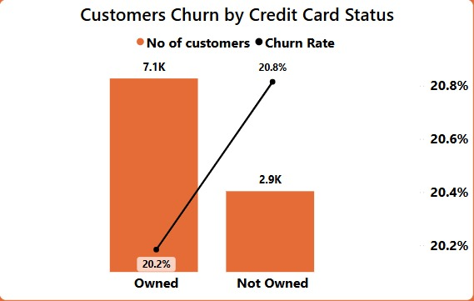
Insight:
Customers without a credit card are churning at a higher rate, suggesting that owning a credit card may be a factor in retention.
Causes: Customers without a credit card leave the bank more often because they have fewer benefits.

Slide 15
Recommendations
BillDesk can implement targeted engagement strategies such as personalized offers, proactive communication, and loyalty programs to reactivate inactive accounts before they close.
To retain long term customers, the bank should give better service, make products easier to use, lower fees, and offer rewards. Improving digital banking and using data to find and help unhappy customers can also reduce churn.
BillDesk can introduce financial education programs, flexible loan repayment plans, and personalized financial advice to support customers with poor credit score, reducing their likelihood of leaving.
BillDesk bank should analyze whether highly engaged customers feel they are not getting enough value or if competitors offer better services. Personalized offers, fee reductions, and loyalty benefits can help retain them.
BillDesk bank can launch targeted campaigns to encourage non-credit card holders to apply for one by offering benefits such as lower fees, cashback, or interest-free periods.
Encouraging customers to use multiple products can reduce churn rate.

Slide 16
THANK YOU

